Slide 1
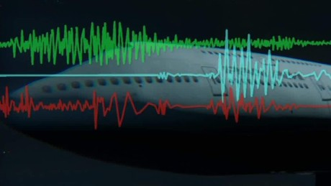
Analysis of Aircraft Crashes

Slide 2
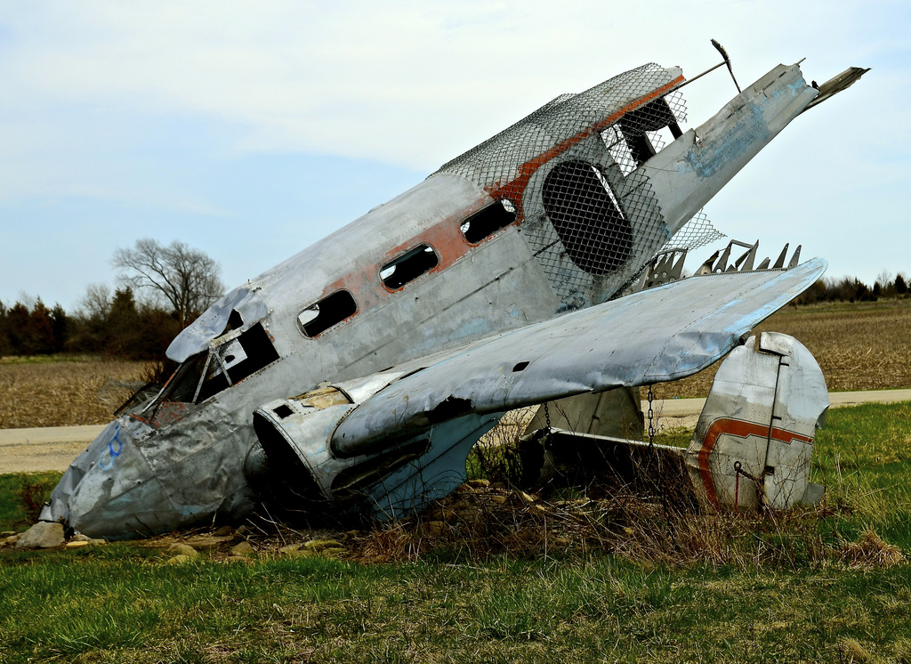
CONTEXT
Air craft crashes is definitely one of the most dangerous and mysterious mishaps .
Identifying cause and casualties and more over take preventive measures is the biggest question .
Analyzing past trend is always helpful in this process ,in our project we have used air crash data for past 100 years and tried to analyzed certain factors and predict results

Slide 3


PROBLEM STATEMENT
We are using aircraft crash data of past 100 years and analyzing -
To find a particular pattern related to the cause
To visual the data and understand the past changes over the years in case of crash
Predict the risk categories (Low/High) for fatalities in a crash by considering aircraft type and number of incidents.

Slide 4

Data Cleaning(huge task)
Data visualization in R and Tableau
Naïve Bayes classification to predict the risk categories (Low/High) i.e., likelihood of people surviving in a crash given a particular aircraft type and other factors.
Finding trends in year wise fatalities rate .
Analyzing Summary of the airplane crashes from the dataset by identifying different clusters

Slide 5

CONCLUSION
Word cloud gave the overview of the
causes of plane crash by showing
the most frequent words used
in the summary.
Data visualization in Tableau gave the
pattern showing the aircraft type ‘Douglas’ is being crashed most of the time compared to
others.
Data Visualization in R gave the pattern showing the large number of aircraft crash is
occurred during the year 1972 in the month of January, August and September.
We have risk of the event in 2 categories: high and low. So, we have applied Bayesian
Classification on Risk Category Data and predicted the accuracy of the event considering
all the factors as 88.5%.

Slide 6


